Slide 1

SSC
8-31-22
Thank you for being here.

Slide 2

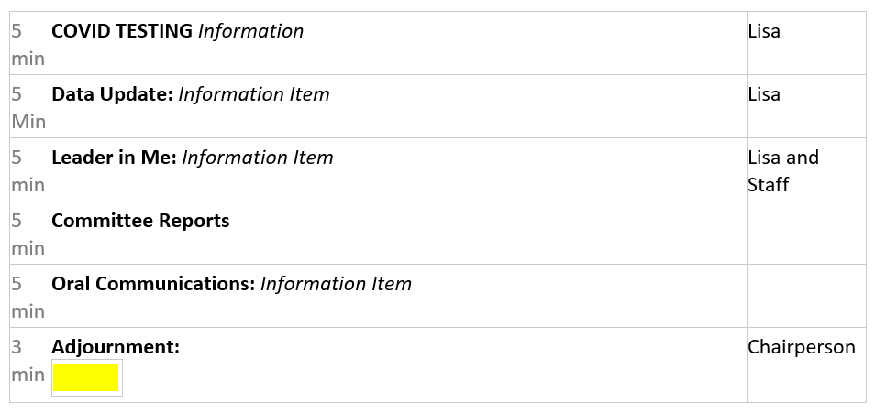
Agenda

Slide 3
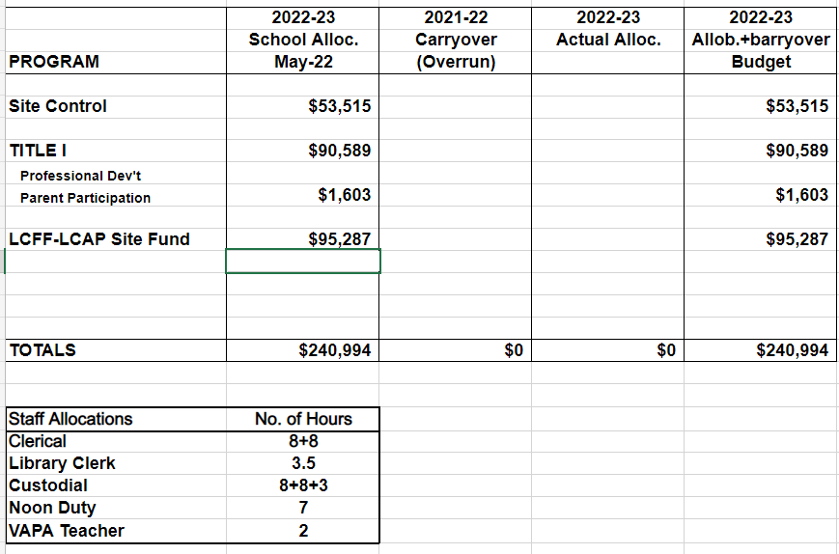
Estimated Budget

Slide 4

COVID UPDATE
Cases are on the decline
Testing on campus every Monday (must register-contact covtest4@cvesd.org)
New return for symptomatic children who have not tested positive:
A symptomatic person must take 1 negative antigen or 1 negative pcr test and may return to school when the following have been met:
24 hours fever-free without the use of fever-reducing medications
Symptoms improving
No new symptom onset

Slide 5
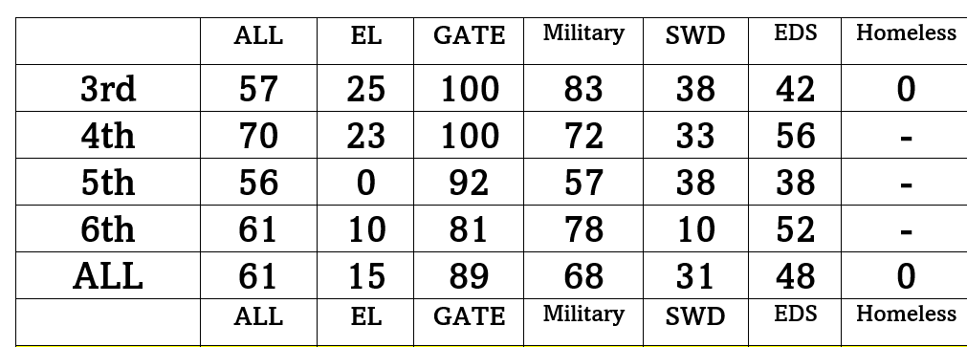
Data Review
CAASPP -ELA

Slide 6
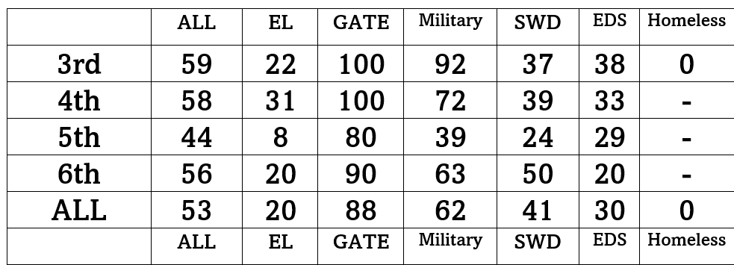
Data Review
CAASPP - Math

Slide 7
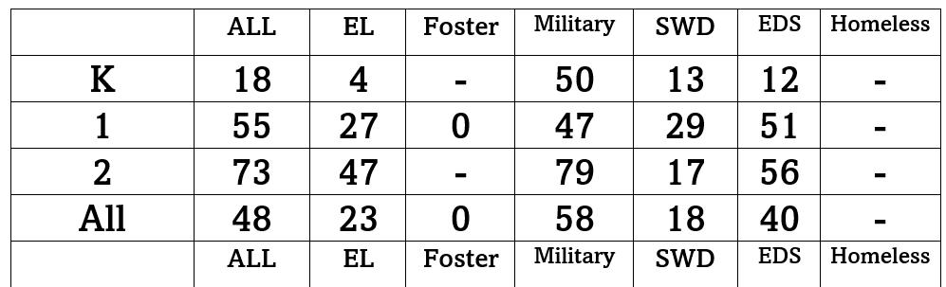
Data Review
Smarty Ants

Slide 8
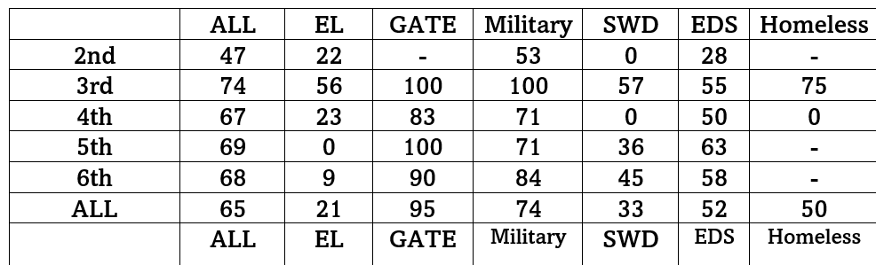
Data Review
Achieve 3000

Slide 9
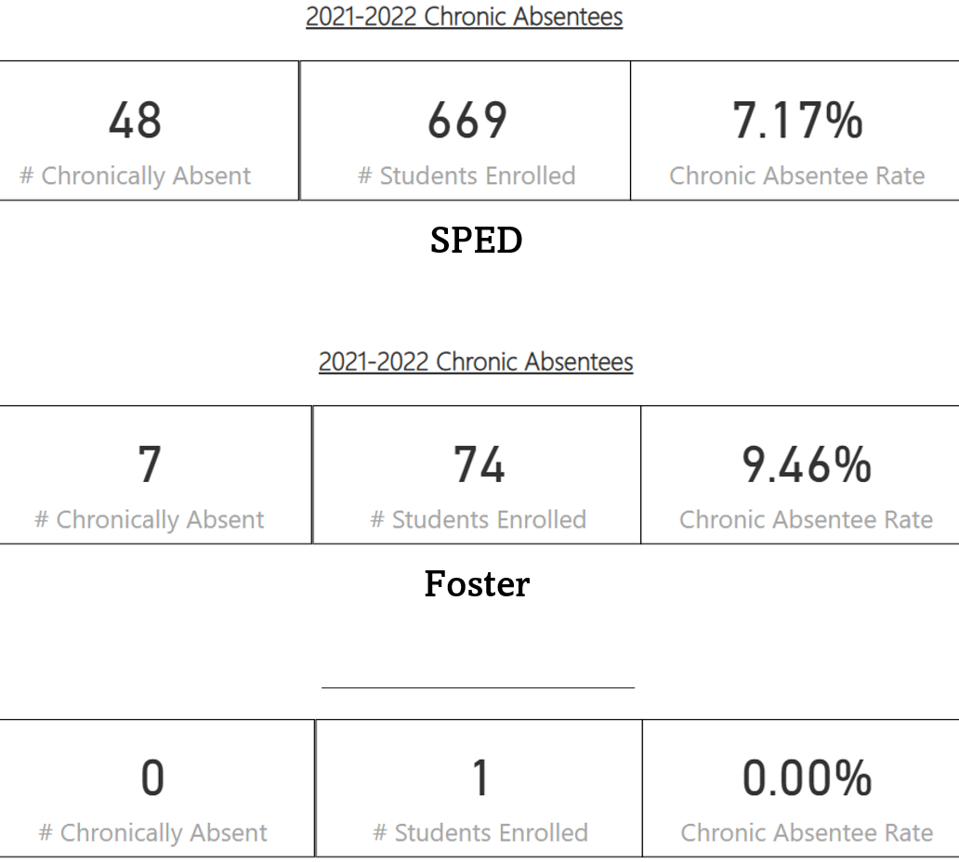
Data Review
Chronic Absenteeism

Slide 10


Slide 11
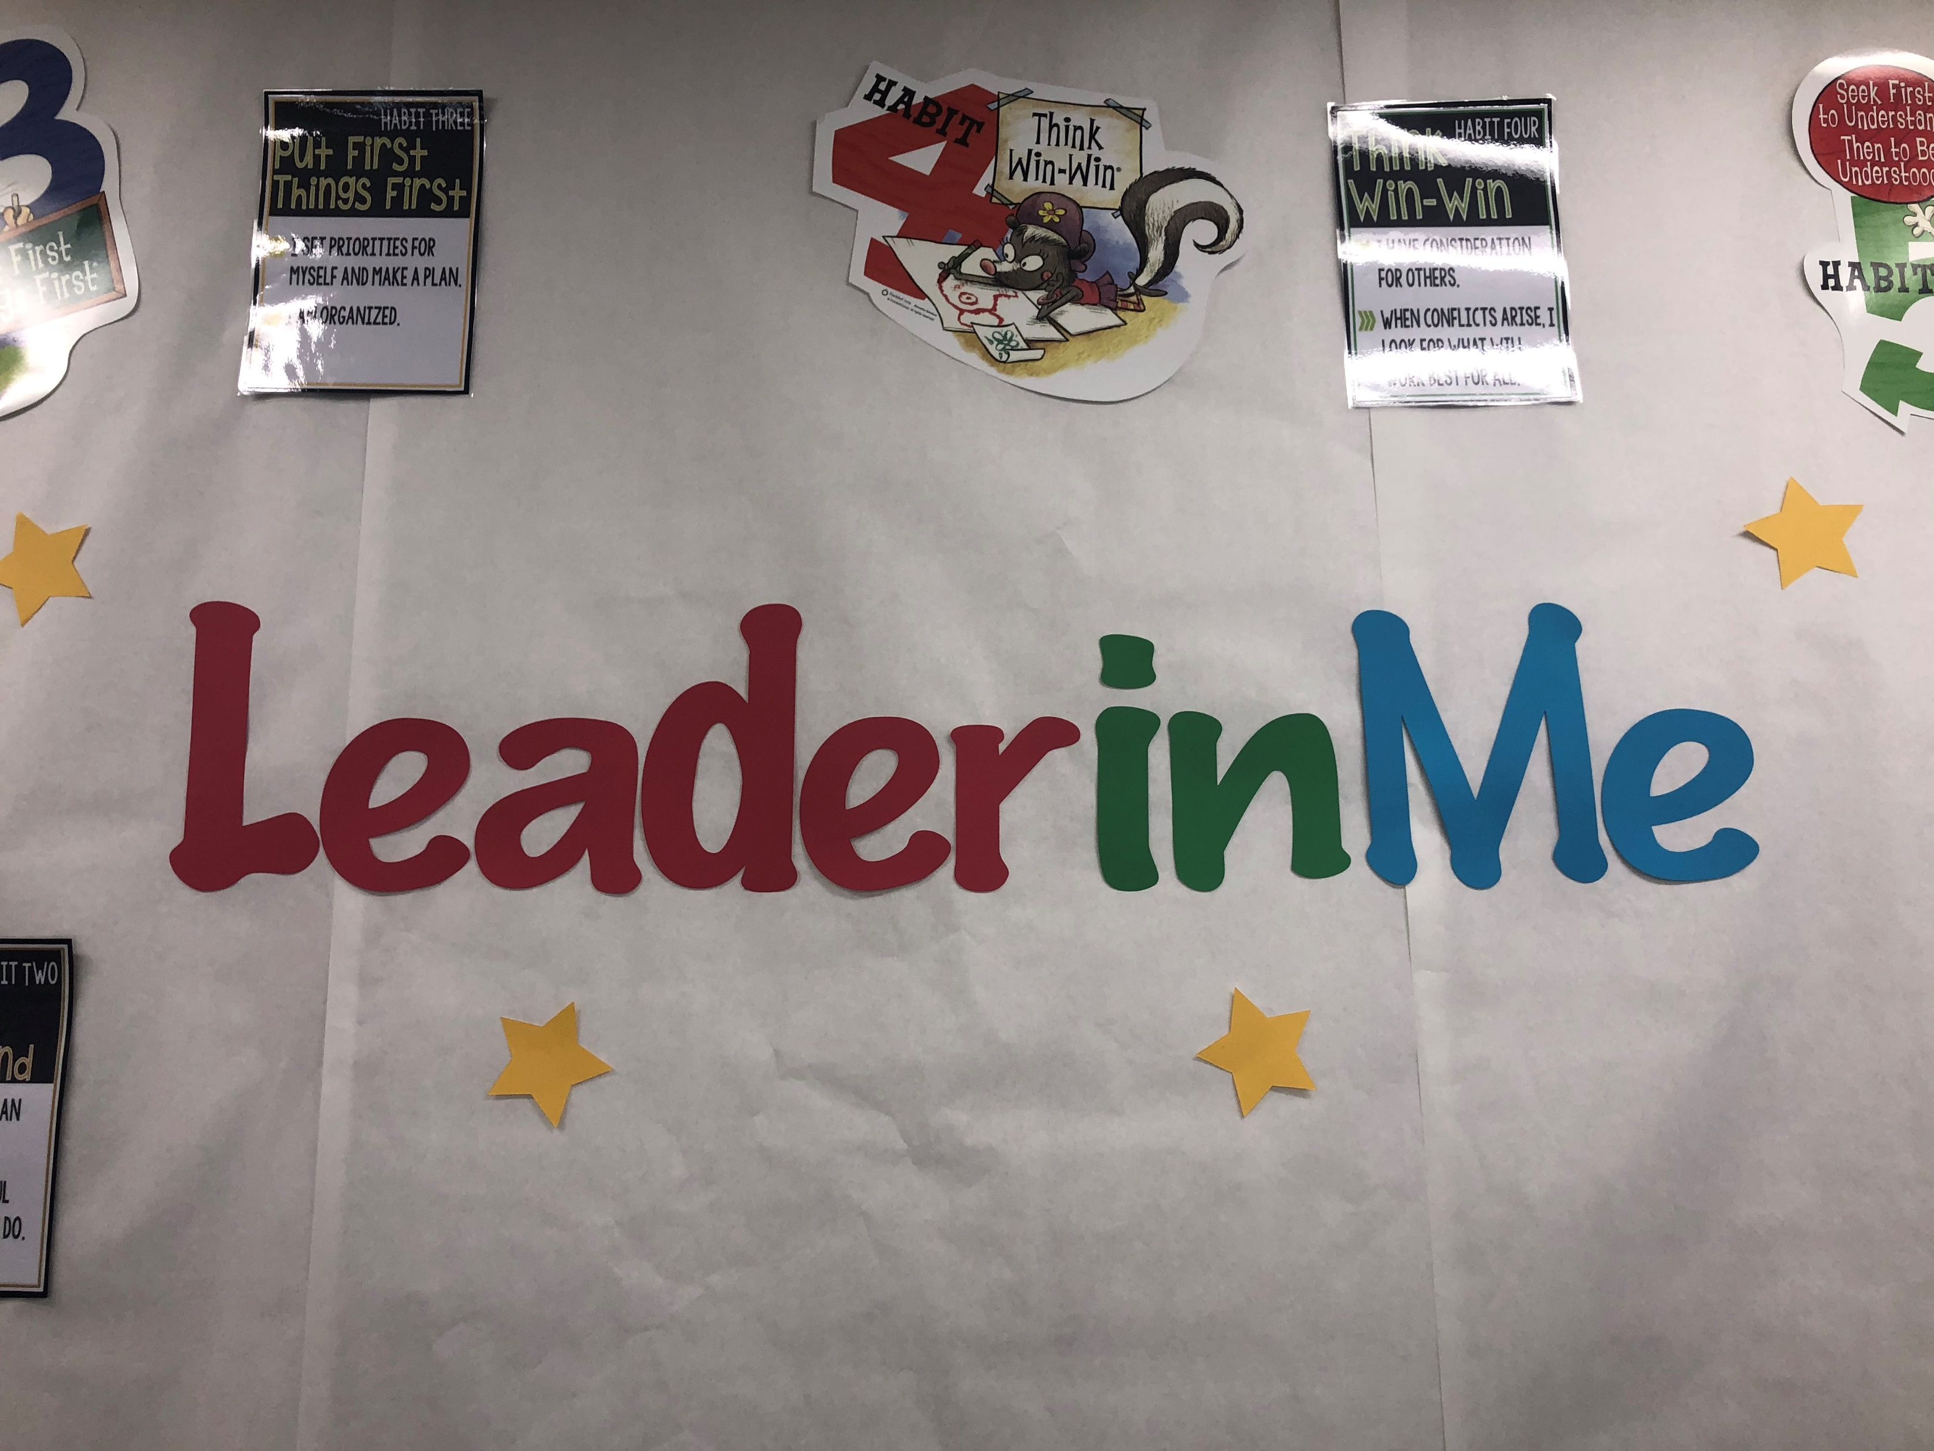
Plans for Year 3:
Based on the MRA results from May 2022, we will focus on the following areas:
Student Leadership:
Self Advocacy
Culture:
Trusting Relationships
Academics:
Student Goals
*We will also be focusing on service learning at school, home, and in the community. We will be conducting a parent training this year as well
We will be applying for Lighthouse School Status this school year!

Slide 12
Committee Reports
OPTC
ELAC
Obstacle Course Challenge
Fall Festival
Dinner Night Fundraisers
Volunteers
Urgent need to support EL’s
We will be electing 11 board members next meeting

Slide 13
Thank you for coming!
Next Meeting: Sept. 14

