Slide 1


Summative
English Language Proficiency
Assessment for California

Slide 2



Excerpt from Board Resolution Statement and Board Policy:
“The Board of Education recognizes the importance of multiliteracy and mastery of two or more languages as a valuable skill for participating in a 21st century diverse world economy.”
“The District provides instructional programs that support students in developing English language proficiency and achieve high academic standards.”

Slide 3
ELPAC
Assessments

Slide 4
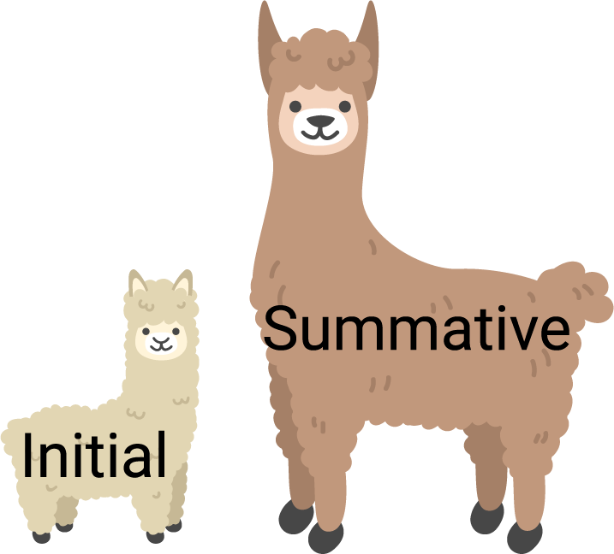
English Language Proficiency
Assessment for California

Slide 5

Initial ELPAC
Summative ELPAC

Slide 6
ELPAC Assessments
Initial ELPAC
Summative ELPAC
Shorter assessment
Goal is to identify students who need support learning academic English
Informs teachers
about instruction
Longer assessment
Goal is to measure annual progress towards learning academic English
Informs teachers about instruction
Provides information about whether a student has met goals for reclassification

Slide 7

Summative ELPAC Testing Windows
Grades TK-2
February 7, 2022 to April, 2022
Grades 3-12
February 7, 2022 to April 11, 2022

Slide 8
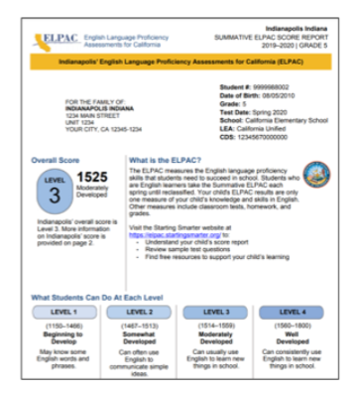
Student Score Report
English Video
https://www.youtube.com/watch?v=au43SE_uymU
Spanish Video
https://www.youtube.com/watch?v=BSTBxl8GMgc

Slide 9
ELPAC
Teacher
Tools

Slide 10

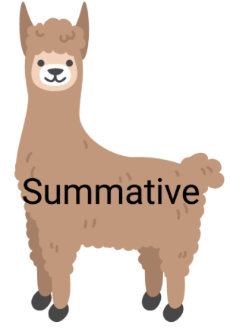

Daily Instruction for Multilingual English Learners
Whole Group
Integrated
and
Small Group
Designated

Slide 11
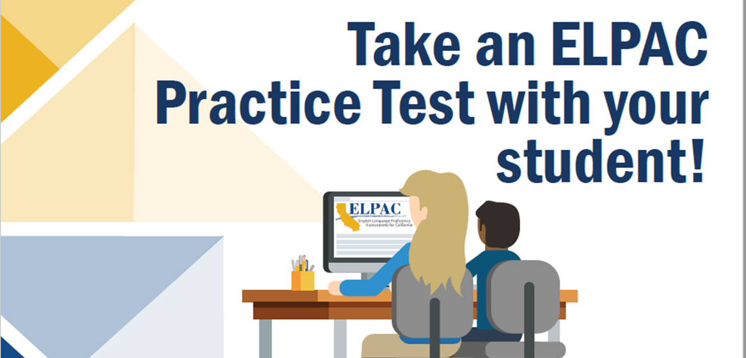
ELPAC Practice Tests and Training Test
https://www.elpac.org/

Slide 12
ELPAC
Parent
Tools

Slide 13
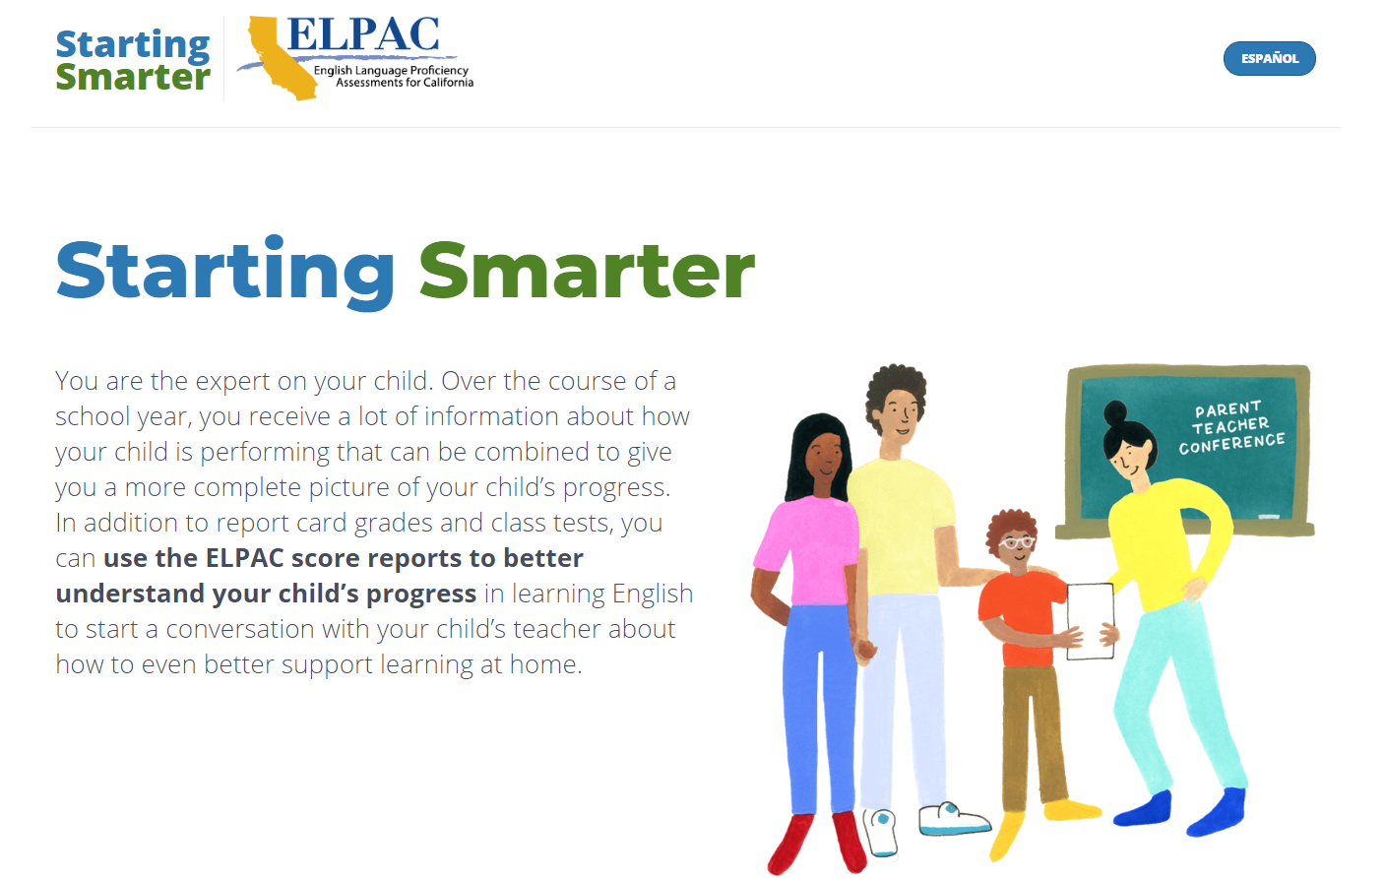
Starting Smarter Parent Website
Click for Spanish
https://elpac.startingsmarter.org/

Slide 14

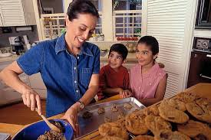

Create Opportunities for Conversation
1. Choose 2. Give Reasons
Bake cookies
Build a puzzle

Slide 15

Create Opportunities for Conversation
Retell stories or movies
Answer questions
Sing Songs
Chant Poems

Slide 16


