Slide 1



Olympic View Families,
Did you know you can help the school earn money as you shop? Box Tops for Education and Amazon Smile are fast and easy ways for you to help out from home. Please support our school as we participate in these cash back rewards programs. Help us reach the goal of $1000.00 for the year from each program, for a total of $2000.00 earned.
Your earnings may seem small, but they really do add up. The more people that participate, the bigger the impact we can make. So let's give our teachers the support they need and help give our kids the extra funds for a better school. Little by little, we can help make a big difference.
All money goes directly to the school. Participation is simple and easy!
Students/Families with the highest quarterly participation will be recognized.
Download the App & Visit the Page. Start earning today!
Thank You for Your Support!
Wendy Lindsey
Box Top & Amazon Smile Coordinator
**Directions and Tip on Backside**

Slide 2
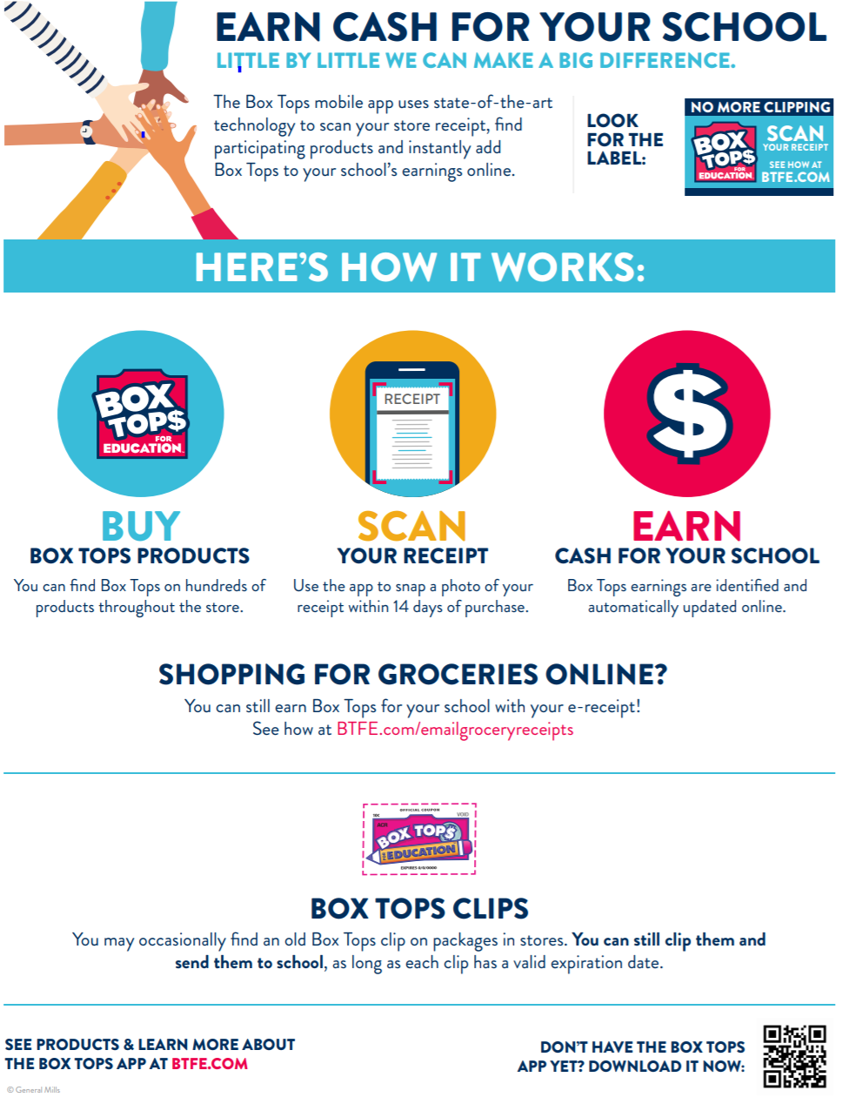
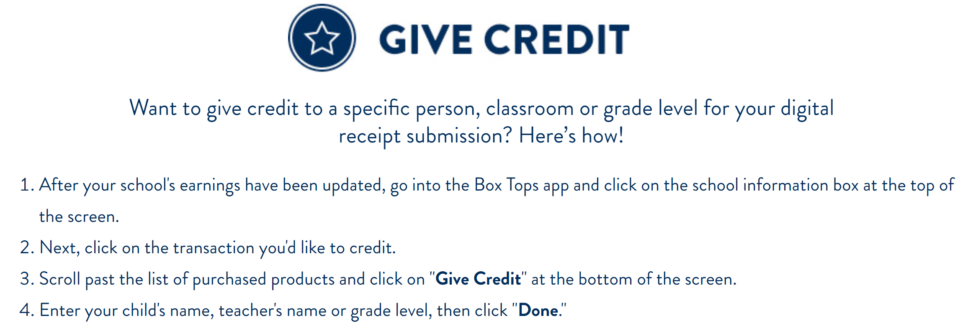

Did you know you can help our school raise money just by shopping on Amazon?
Here’s How…
Step 1: Use this amazon link:
https://smile.amazon.com
Step 2: When asked to pick a charity, enter “Olympic View Parent Teacher Club” in the search box
and then choose our school.
Step 3: Log in with your normal amazon username and password.
Start Shopping!
Each time you shop on Amazon use smile.amazon.com. Our school earns money with each purchase! It's that easy!
Thanks for your support!

