Slide 1
Leader in Me
Parent Workshop
The Interpersonal Habits
4: Think Win-Win
5: Seek First to Understand, Then to Be Understood
6. Synergize
Olympic View Elementary: March 17 , 2021
Notes:
Lisa

Slide 2

Olympic View
Student Lighthouse Team!!!
Let's Meet Our Student Lighthouse Team for 2021!
Notes:
Erin

Slide 3

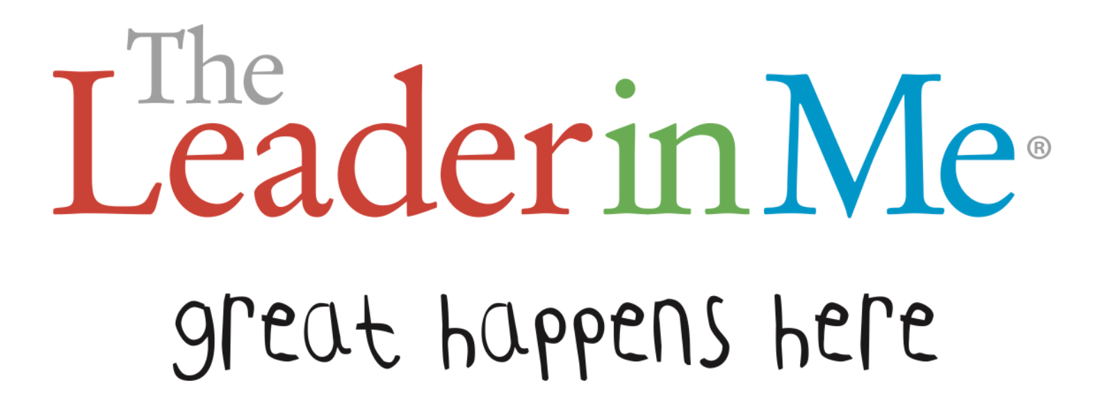
Goals & Objectives:
To gain an understanding of habits 4, 5, and 6.
To understand why habits 4, 5, and 6 are essential to school and life success.
To walk away with ideas on how to promote habits 4, 5, and 6 at home with your family.
Notes:
Erin

Slide 4
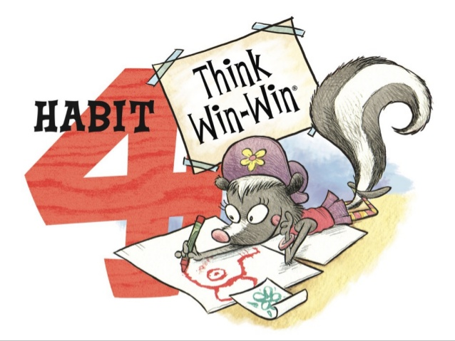
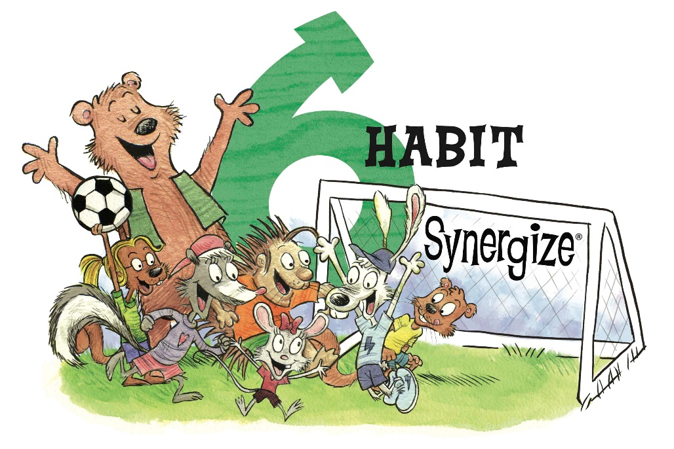
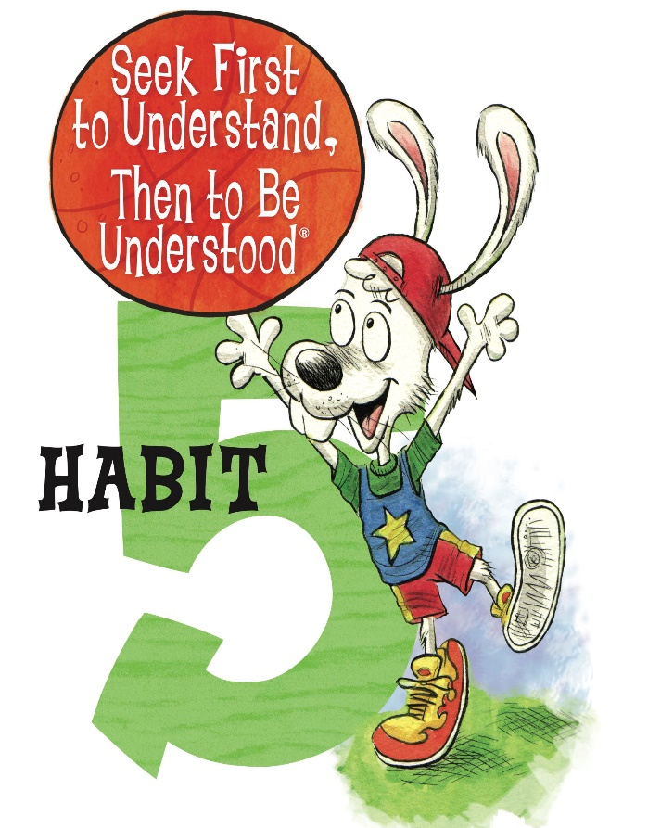
The Interpersonal Habits
Notes:
Manda

Slide 5

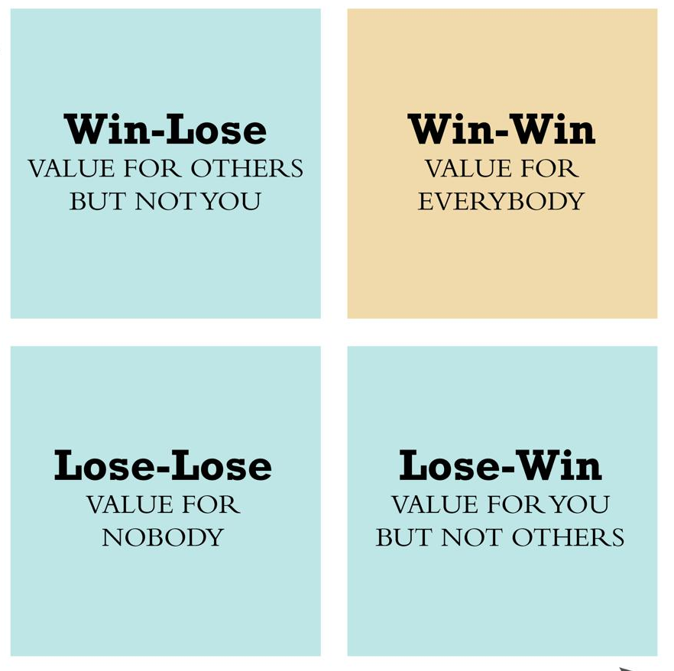
What is Habit 4?
This is the habit of Thinking Win-Win
Frame of mind and heart that seeks mutual benefit in all human interactions
It takes courage to seek mutual benefit from all human interactions.
Balancing others needs with your needs and wants
Cooperative not competitive mindset
Abundance Mentality – enough for everyone
Building Trusting Relationships
  Looks like "You can count on and trust me"
  Emotional Bank Account Deposits
  The Golden Rule!
Notes:
Lisa

Slide 6
Why is Habit 4 Important?
People who Think Win-Win:
See life as a cooperative arena, not a competitive one
Have an abundance mentality: "There is enough for everyone!"
Work with others to create a win-win agreements
Help all people involved feel valued
Know how to make deposits in others' Emotional Bank Accounts
Know how to keep their own Emotional Bank Accounts from being depleted.
Therefore, They Are:
Considerate, courageous, generous, and thoughtful
Better able to navigate conflicts and problem solve
Better able to work well in groups
Better able to maintain healthy personal and professional relationships
More successful in school, at work, and in life.
“When one side benefits more than the other, that’s a win-lose situation. To the winner it might look like success for a while, but in the long run, it breeds resentment and distrust.”
–DR. STEPHEN R. COVEY
Notes:
Lisa

Slide 7

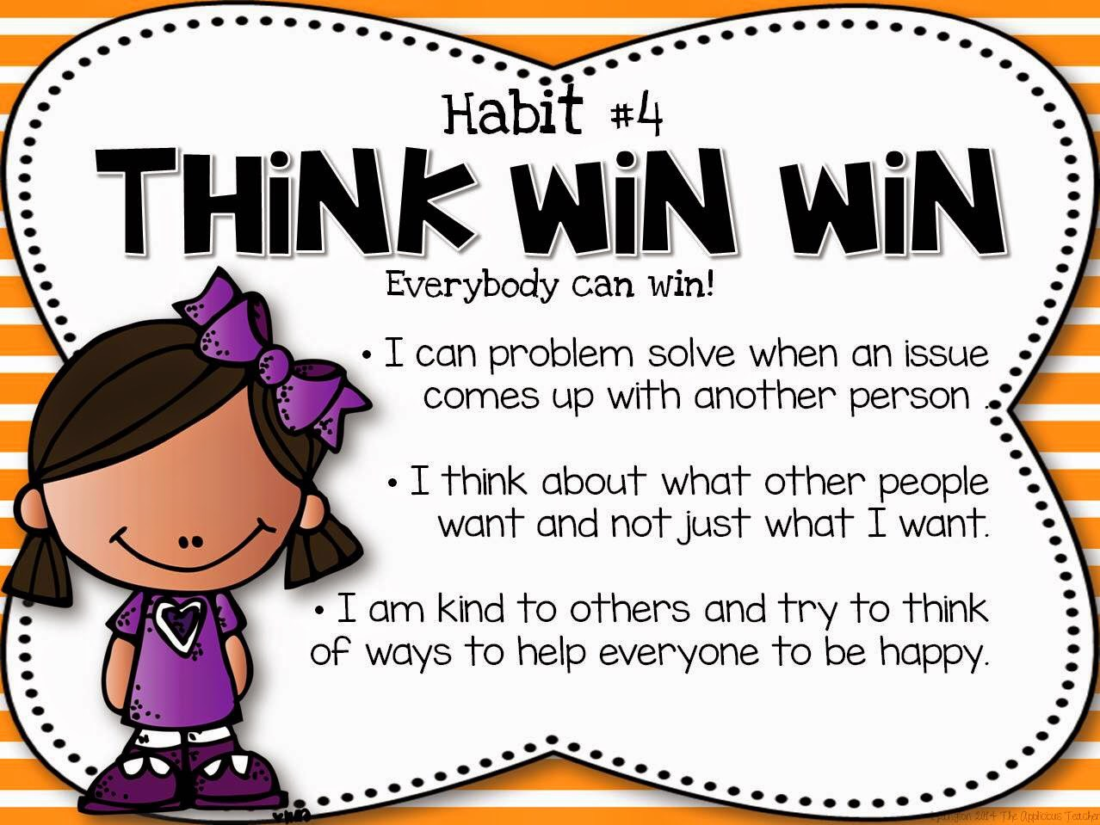
How Can I Promote Habit 4 at Home?
Lead by Example:
Model by making deposits into your child's and others' Emotional Bank Accounts
When conflicts arise model finding that Win-Win Solution.
Participate in a community service event and discuss how community service is a Win-Win.
Model cooperation instead of competition and the abundance mentality
Use the language of Habit 4
Help Your Child:
Focus on what is best for the family: "We" not "Me"
Practice using kind words to come to agreements and solutions
Practice treating others the way you want to be treated.
Have Family Emotional Bank Account Deposit Practices
Notes:
Lisa

Slide 8

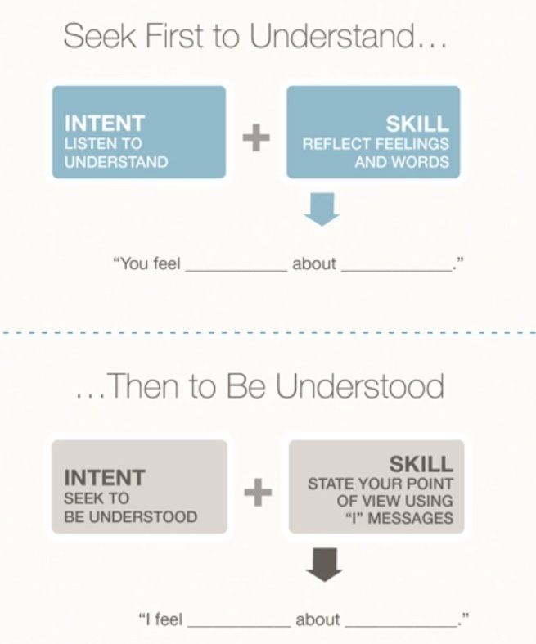
What is Habit 5?
This is the Habit of Seeking First to Understand.......
Listen to people sincerely with your eyes, ears, & heart
Empathic Listening: the intent is to listen and understand others within their frame of reference
Requires that you listen to understand and reflect on the person's feelings and words
Fully understand others before trying to get your own point across
Sometimes people just want to be heard
It's Not About the Nail
Then to Be Understood:
When you fully understand the other person or people, then it is your turn to be understood
Be Honest, Be Kind, Be Sincere when trying to get others to understand you.
Think before you speak
State your point of view using "I" Messages
Notes:
Manda

Slide 9

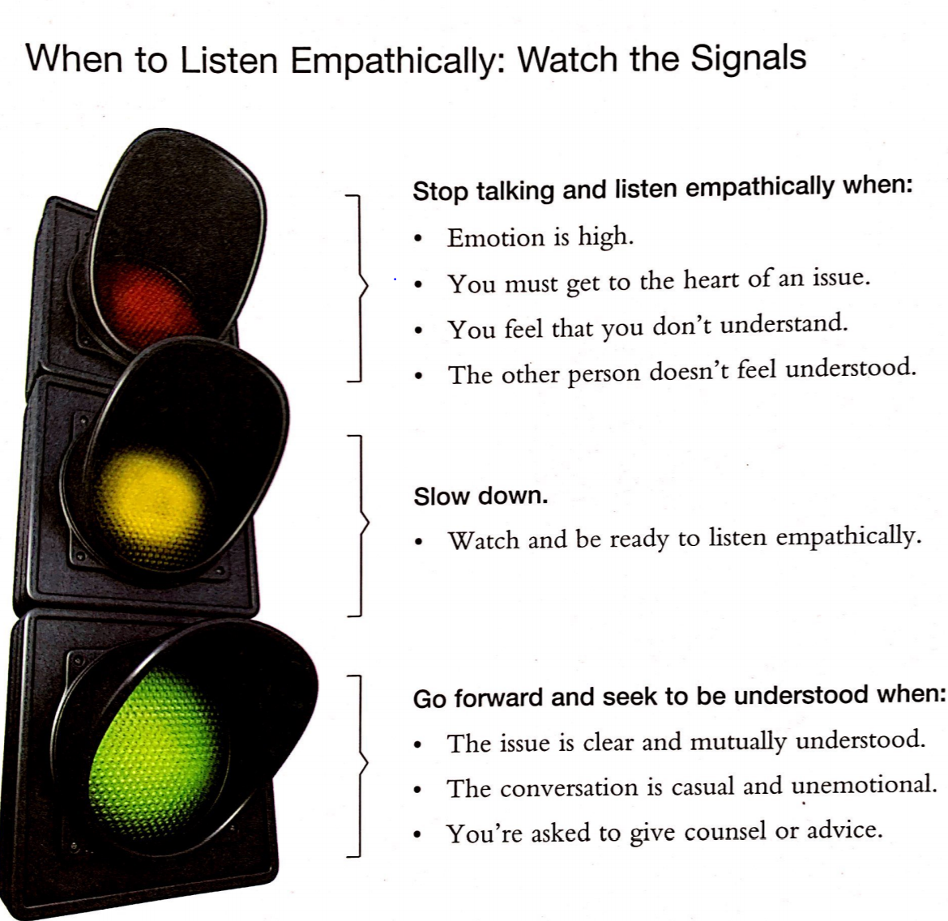
Why is Habit 5 Important?
People Who Seek First to Understand:
Watch the signals
Stop talking & listen when emotion is high
Slow down and watch, be ready to listen & ask clarifying questions
Go forward & seek to be understood when all parties are on the same page
Therefore, They Are:
Empathetic and Respectful
Better able to Navigate Conflicts and problem solve
Are more likely to have leadership positions at school and in the workplace
Very successful academically and professionally because they can work well with others
Better able to maintain healthy relationships with others
Notes:
Manda

Slide 10

How Can I Promote Habit 5 at Home?
Lead By Example:
Model sincere listening when interacting with your children or with other adults
  Put away distractions, look at your child, and let them speak
  Truly hear them out before reacting, giving opinions or ideas, or stating your side
  Sometimes our children just want to be heard
  Try to listen empathetically
Model Using "I" Messages when speaking "I feel _____ about ______."
Help Your Child:
Practice their listening skills (whole body listening)
Practice using "I" Messages
Ask your child how it makes them feel when someone tries to understand them
Ask them ways they can try to better understand others (siblings, family members, classmates, teachers, etc.)
Positively reinforce when they seek to understand (catch them in the act and point out their sincere listening)
Remind your child that we have two ears to listen twice as much as we speak.
“Most people do not listen with the intent to understand; they listen with the intent to reply.”​
​
–DR. STEPHEN R. COVEY
Notes:
Manda

Slide 11

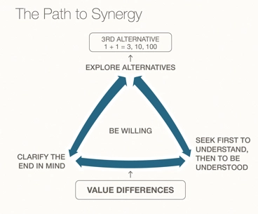
What is Habit 6?
This is the habit of Synergizing:
The Nature of Synergy: “Two heads are better than one!”
Together we can produce far better results than we could on our own.
Creative cooperation and teamwork at its best
Open-mindedness and valuing diversity
Understanding that everyone brings different points of view, different strengths, and different ideas to a team and then valuing and using these differences to benefit the team and boost success.
It is working together to find 3rd Alternatives - new and better solutions
Synergy is a process where people bring all their personal experience, strengths, and expertise to the table.
A cohesive unit working together to reach an end goal
Notes:
Erin

Slide 12

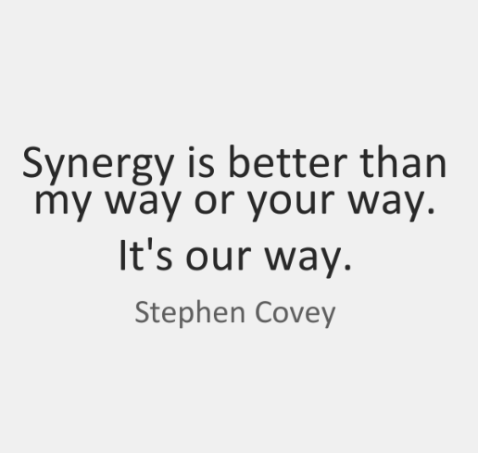
Why is Habit 6 Important?
People Who Synergize:
Are open minded
Understand that "together we are better"
Value diversity and differences
Enjoy working with others
Are cooperative and want to find the best solution or idea – 3rd Alternative
Put the team and the end goal first
Know their own strengths and value the strengths of others
Therefore, They Are:
Better able to navigate conflicts and problem solve
Better able to work well in groups
Better able to maintain healthy personal and professional relationships
More successful in school, at work, and in life
More likely to hold leadership positions at school and work
Notes:
Erin

Slide 13

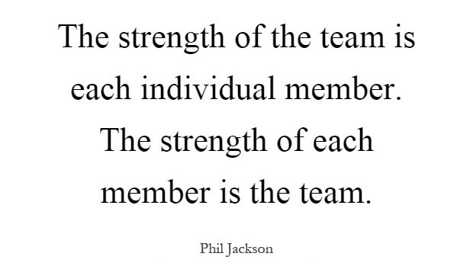
How do I Promote Habit 6 at Home?
Lead By Example:
Work as a team at home every chance you get – cooking dinner, washing the car, doing a puzzle together, planning and making gifts for others, etc.
Know your own strengths and model asking for help
Recognize and value the different strengths of your family members
Ask your family for input or ideas when making decisions or solving problems, when applicable, to find those 3rd Alternatives:
  What to have for dinner, how to spend Saturdays, where to go on vacation, creating a schedule that works for everyone, prioritizing chores, dividing up house or yard work, etc.
Help Your Child:
To identify their own strengths
By giving them opportunities to use their strengths within the family
To recognize and value the strengths of each family member
Notes:
Erin

Slide 14


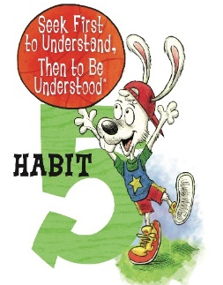
Tangible Take-Aways:
Lead By Example & Help Your Child
Create Family Emotional Bank Account Deposit Practices
When conflicts arise model finding that Win-Win Solution. ​
Participate in a community service event and discuss how community service is a Win-Win. ​
Encourage cooperation instead of competition
Encourage the abundance mentality​
Focus on what is best for the family: "We" not "Me"​
Work as a team at home every chance you get
Know your own strengths and model asking for help
Recognize and value the different strengths of your family members
Ask your family for input or ideas when making decisions or solving problems, when applicable, to find those 3rd Alternatives:
Help your child identify their own strengths
Give them opportunities to use their strengths within the family
Model sincere listening when interacting with your children or with other adults ​
Model Using "I" Messages when speaking
Help your child practice their listening skills (whole body listening)​
Help your child Practice using "I" Messages​
Remind your child that we have two ears to listen twice as much as we speak.​
Notes:
Erin

Slide 15

Wrap Up & Questions
Did we meet our goals?
  To gain an understanding of habits 4, 5, and 6.
  To understand why habits 4, 5, and 6 are essential to success.
  To walk away with ideas on how to promote the habits 4, 5, and 6 at home with your family.
Notes:
Lisa

Slide 16
Credits
Information, videos, and visuals for this workshop are from:
The Leader in Me Program and Curriculum: https://www.leaderinme.org/
Franklin Covey’s 7 Habits Website: https://www.franklincovey.com/the-7-habits/habit-1/

