Slide 1
Leader in Me
Parent Workshop
The Interpersonal Habits
1: Be Proactive
2: Begin with the End in Mind
3. Put First Things First
Olympic View Elementary: December 9, 2020
Notes:
Lisa

Slide 2


Goals & Objectives:
To gain an understanding of the first three habits.
To understand why the first three habits are essential to success.
To walk away with ideas on how to promote the first three habits at home with your family.
Notes:
Erin

Slide 3
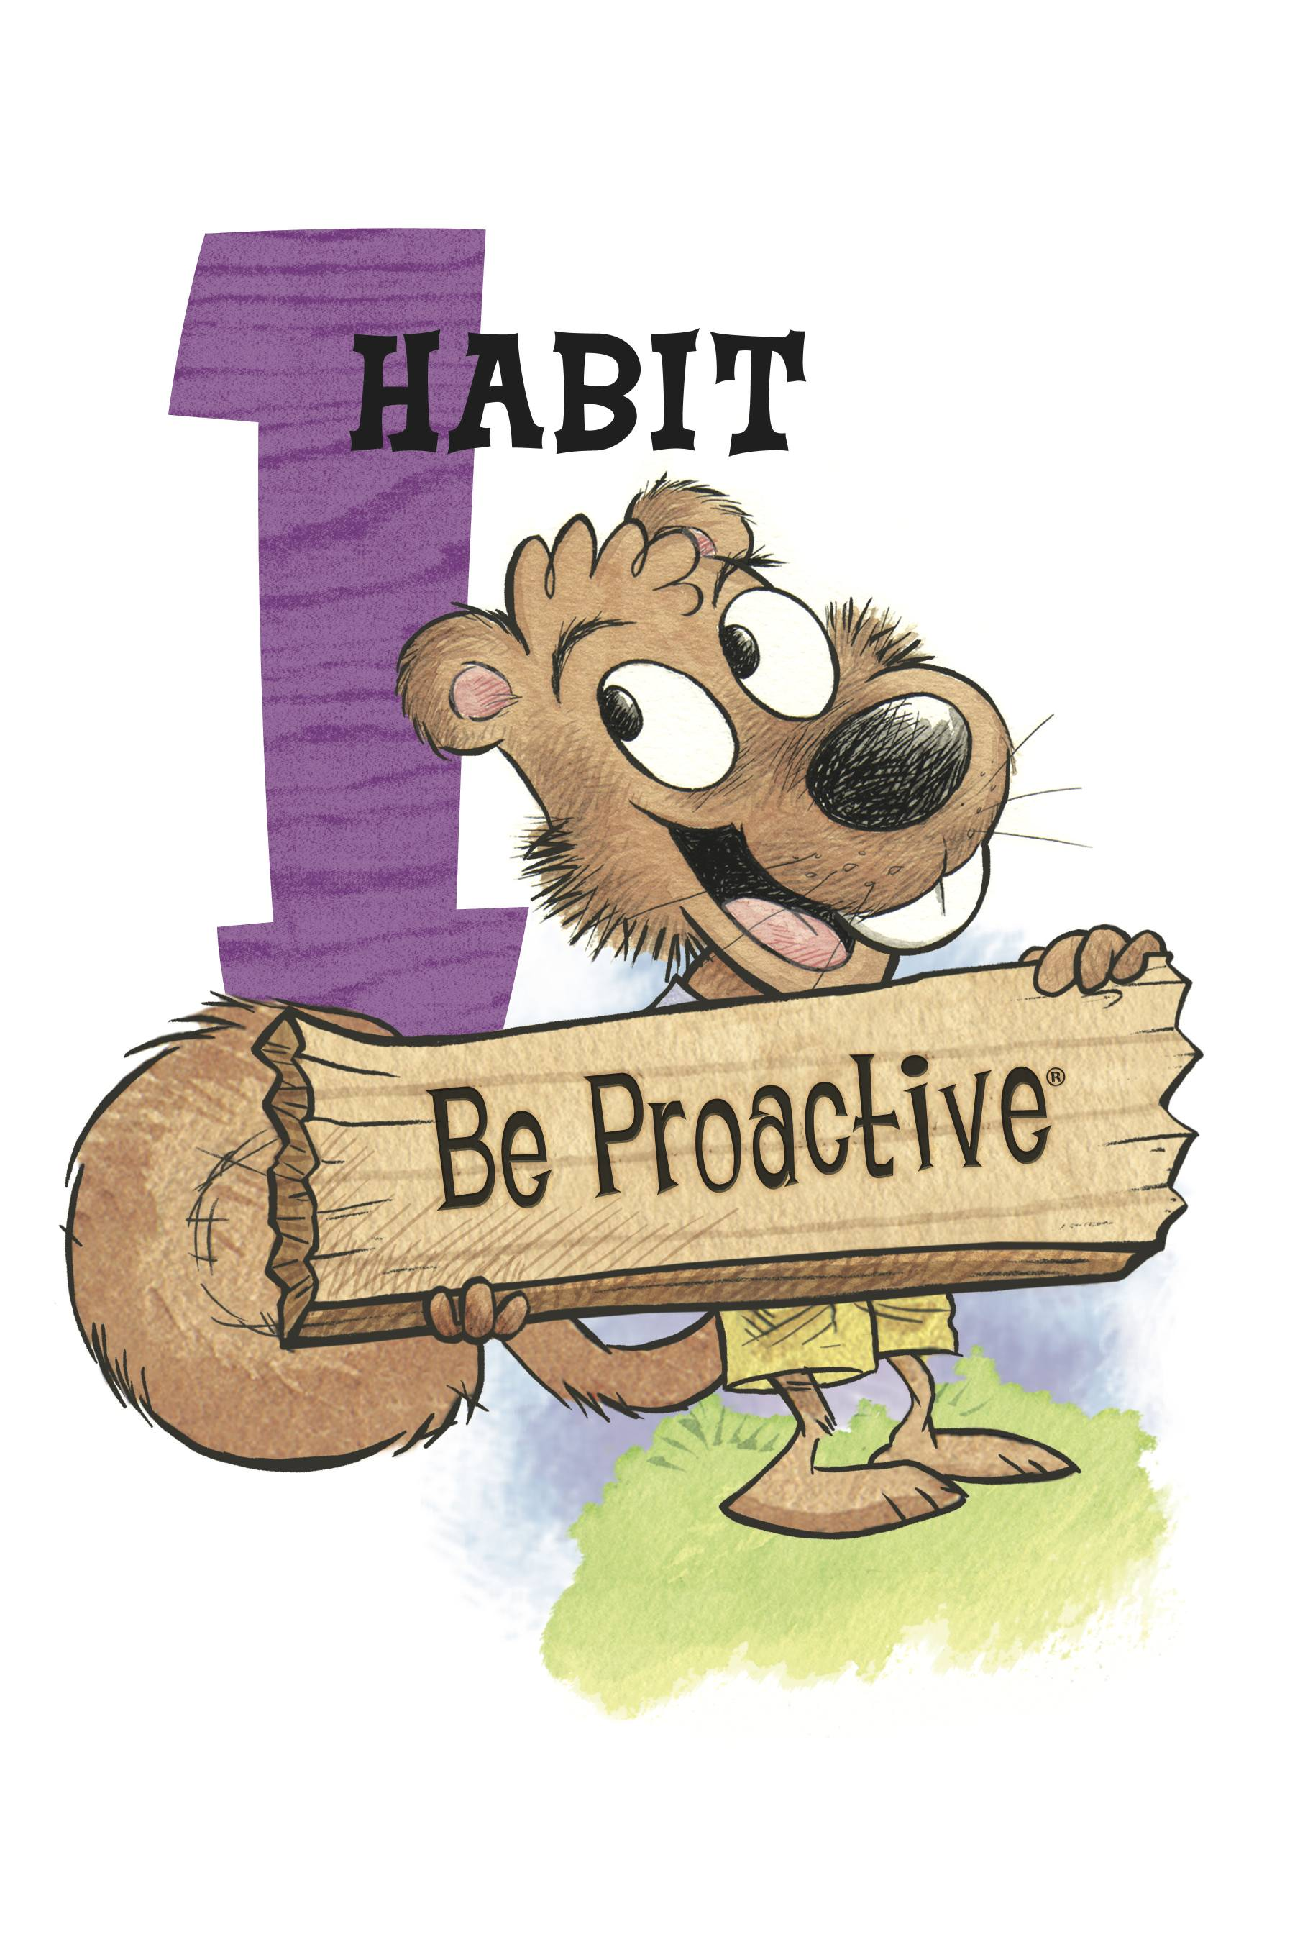
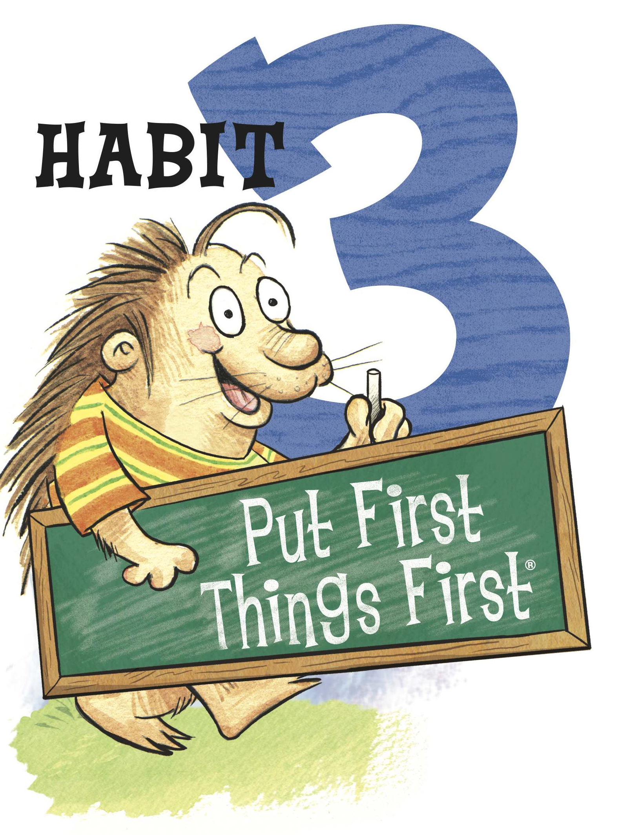
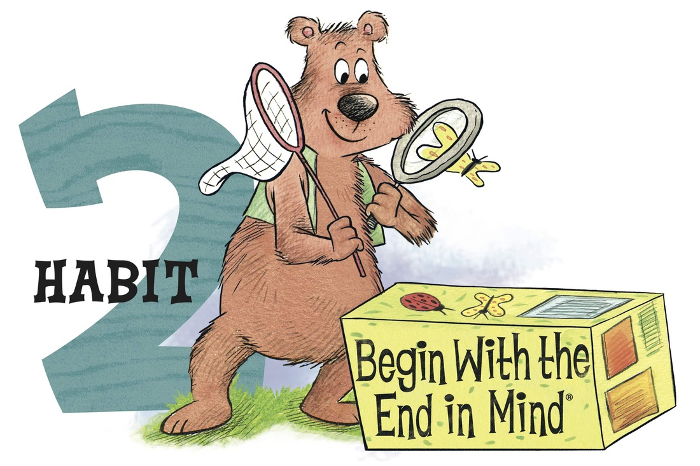
The Interpersonal Habits
Notes:
Manda -

Slide 4
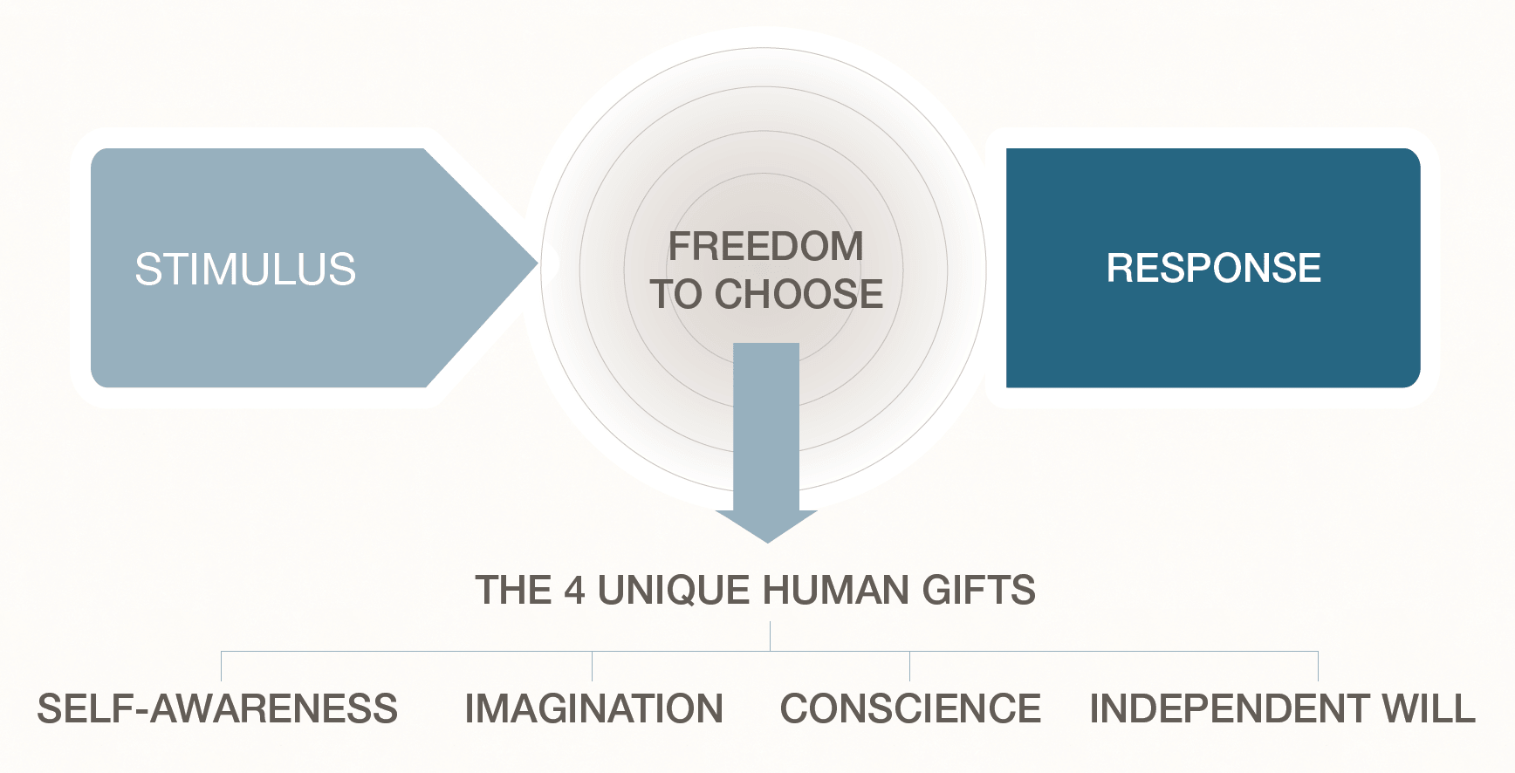
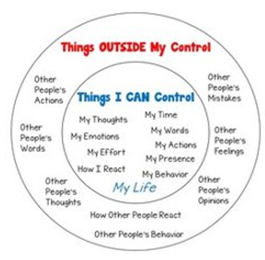
What is Habit 1?
The Habit of Personal Responsibility:
Being responsible for our own life and the choices we make.
We have the freedom to choose based on principles rather than mood or condition.
4 components of being proactive:
    Pause and respond based on principles and desired results – Proactive vs. Reactive
    Use proactive language (Growth Mindset)
    Focus on your Circle of Control
    Model Positive Behavior and pass on effective habits to build others
These components are all relevant to the relationship between adults and children.
Notes:
Manda

Slide 5

Why is Being Proactive Important?
People who are Proactive:
Have Better Self –Regulation Skills
Spend their time and focus on the things they CAN control and change.
Have a Growth Mindset
Have a Positive Outlook – Choose to Be Sunny
Therefore, They Are:
Better able to navigate stressful situations
More productive
Achieve More Academic and Career Success
Happier and tend to feel more fulfilled in Life
Notes:
Manda

Slide 6

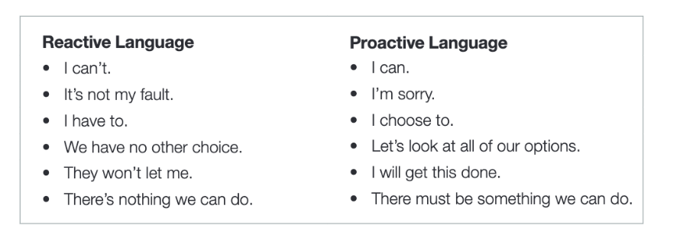

How Can I Promote Habit 1 at Home?
Lead by Example:
Be Proactive about your own responsibilities
Use Proactive Language
Model Growth Mindset Behavior and Language
Model Being Positive (even when it's not easy)
Focus on your circle of control – You can't always control the way your child reacts to something, but you can control how you respond to your child's behavior.
Help Your Child:
Make a Responsibility list or chart with your child(ex: making bed, getting ready, putting toys away, setting the table, completing assignments, walking the dog, charging device, etc.)
Check each item off after it has been completed.
Remind your child to ask themselves, "is this in my circle of control?"
Encourage your child to have a Growth Mindset & use positive, proactive language.
Praise your child every time you "catch" them being proactive, taking initiative, & taking responsibility!
Notes:
Manda

Slide 7

What is Habit 2?
This is the Habit of Beginning with the End in Mind:
Begin with the End in Mind means to begin each day, task, or project with a clear vision of your desired direction & destination
Then continue by setting goals and flexing your proactive muscles to make things happen.
Creating a Vision for Our Lives:
  Know What Matters Most - Think About Your 80th Birthday
  Personal Mission Statement Based on What You Value Most.
Setting Goals:
  Goals Give Direction & Ignite Motivation
  Goals are Specific & Attainable
  Goals can be long term or short term
  Goals are connected to your vision or personal mission in life
“Your most important work is always ahead of you, never behind you.”
~DR. STEPHEN R. COVEY
Notes:
Erin

Slide 8
Why is Habit 2 Important?
People Who Practice Habit 2:
Know What Matters Most in Their Lives
Have a Clear Vision of Their Future & the Person They Want to Be
Are Goal Oriented
Are Motivated
Therefore, They Are:
More Productive
More Likely to Achieve Academic & Career Success
More Likely to Have Positive Personal and Professional Relationships
More Likely to be happier and have higher feelings of life satisfaction
“People are working harder than ever, but because they lack clarity and vision, they aren’t getting very far. They, in essence, are pushing a rope with all of their might.”
~ DR. STEPHEN R. COVEY
Notes:
Erin

Slide 9
How Can I Promote Habit 2 at Home?
Lead By Example:
  Write your own personal mission statement & make it visible
  Write a Family Mission Statement together & make it visible
  Write your own goals & make them visible
Help Your Child:
Make time to help your child identify & write goals
    Make goals that are specific and attainable (examples: Read 20 minutes each day, make my bed daily, do 20 minutes of I-Ready each day, etc.)
    Discuss why the goals are important to your child
    Make a plan to achieve the goals
    No more than 2-3 goals at a time
    Post the Goals in a place where child can them often!
    When a goal is met, celebrate! Then write a new one
Notes:
Erin

Slide 10
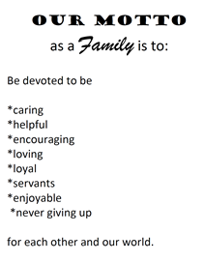
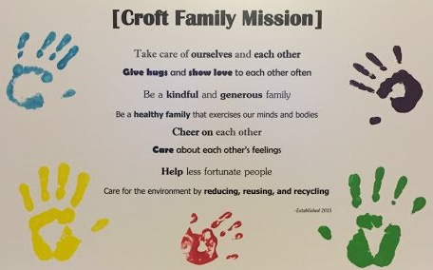

How Can I Promote Habit 2 at Home?
Family Mission Statements: Specific, Attainable, & Based on What you Value as a Family
Notes:
Erin

Slide 11
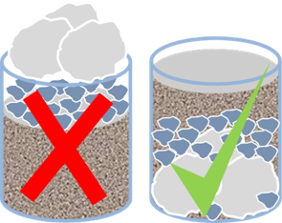
What is Habit 3?
This is the Habit of Putting First Things First:
Recognizing & prioritizing time & Important tasks
Identifying Your Big Rocks and Putting Them First
Organizing a schedule that emphasizes a "Work First, Then Play" mentality
Focusing on Mission, Roles, and Goals set during Habit 2
Schedule big rocks first, then organize the rest
Quadrant 2 Living
“If the big rocks don't go in first, they aren't going to fit later!”
~DR. STEPHEN R. COVEY
Notes:
Erin

Slide 12
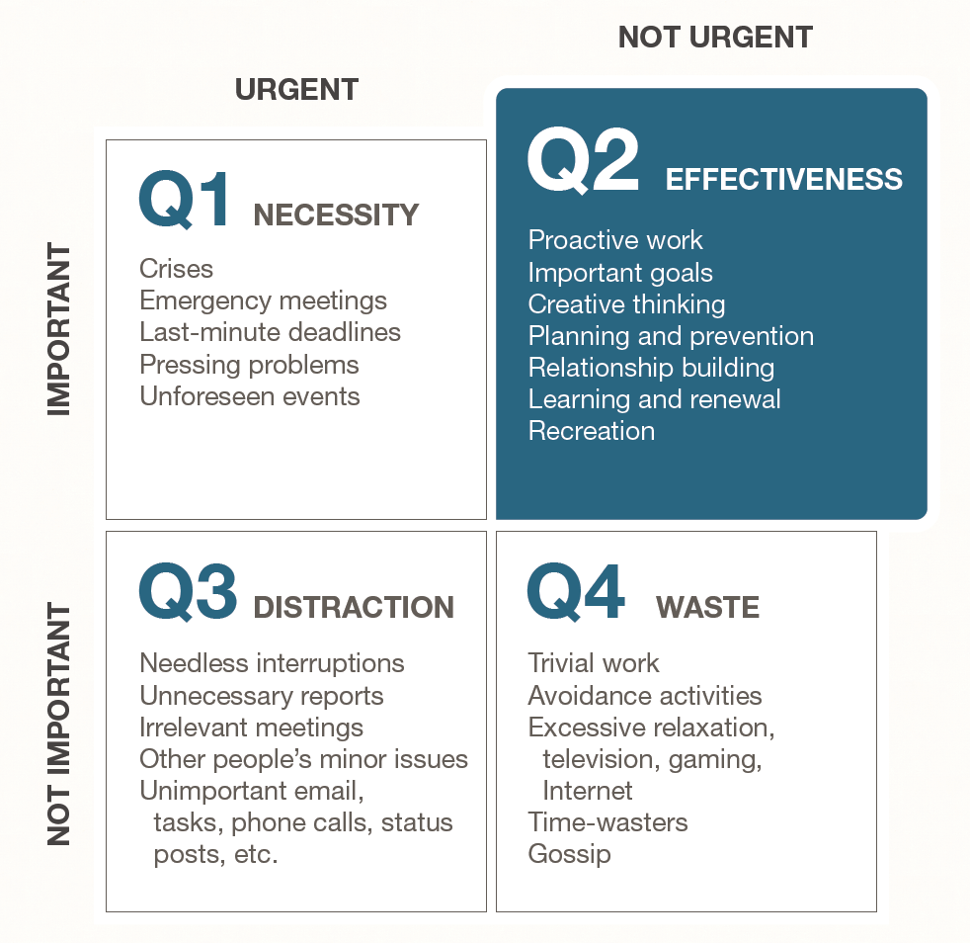
What is Habit 3?
It's Quadrant 2 Living!
Notes:
Erin

Slide 13
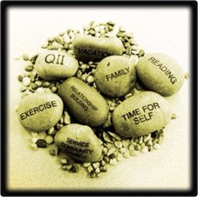
Why is it Important to Put First Things First?
People Who Put First Things First:
Say No to Less Important Things
Eliminate the Unimportant
Can efficiently focus on important goals
Are more organized and use their time more effectively
Therefore, They Have:
More time for Family and Friends
More successful relationships in Life
More productivity and success both at home and at work
Notes:
Erin

Slide 14
How do I Promote Putting First Things First at Home?
Lead By Example:
Identify your own big rocks and little rocks and make it visible
Create a Weekly or Monthly Schedule or Calendar for yourself or the family and make it visible:
  Connect to Your Mission, Roles, and Goals
  Schedule the Big Rocks First
  Then Organize the Rest
Help Your Child:
Create a positive avenue of communication. An example may be a "Family Meeting"
Plan Family time – play a board game, do an art project together, enjoy the outdoors, or make a meal together
Help your child to plan their day, week or month. Use a "to do" list, checklist and calendar to prioritize activities
Notes:
Erin

Slide 15
Tangible Take-Aways:
Lead By Example & Help Your Child
Use Proactive Language & Growth Mindset Language
Choose to Be Sunny & help your child the find the positives
Focus on your circle of control & Help your child focus on their Circle of Control
Create a Responsibility Chart with your Child
Praise your child when you catch them being proactive!
Work First, Then Play
Set up daily communication (breakfast time or dinner)
Use tools (schedules, calendars) to help your child organize and plan
Identify & Schedule your Big Rocks first & Help your child do this too!
Schedule time for the family to meet and connect
Write your own personal mission statement and make it visible
Write a family Mission Statement and make it visible
Write 2-3 of your own goals
Help your child identify 2-3 goals that they can work on
Celebrate when goals are accomplished, then set new goals
Notes:
Lisa

Slide 16

Wrap Up & Questions
Did we meet our goals?
  To gain an understanding of the first three habits.
  To understand why the first three habits are essential to success.
  To walk away with ideas on how to promote the first three habits at home with your family.
Notes:
Lisa

Slide 17
Credits
Information, videos, and visuals for this workshop are from:
The Leader in Me Program and Curriculum: https://www.leaderinme.org/
Franklin Covey’s 7 Habits Website: https://www.franklincovey.com/the-7-habits/habit-1/
Notes:
Lisa

