Slide 1

Promoting a Growth Mindset at Home
Olympic View Parent Workshop
September 30, 2020
Notes:
Lisa – Welcome and Thank the Parents

Slide 2

Workshop Goals and Objectives
We will understand What Growth Mindset is (10 minutes).
We will understand Why Growth Mindset is important (10 minutes).
We will learn How to promote a Growth Mindset at home (10 minutes).
Notes:
Erin I will go over goals and objectives and also give a little background on the work we have been doing as a staff at OV

Slide 3

Science of Character
Notes:
Lisa – Intro to the Video and then tie in at the end to the work we are doing at OV

Slide 4
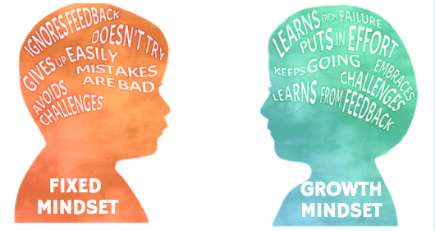
What is a Growth
Mindset?
Research:
  Carol Dweck
The Brain:
  How does it work?
Video on Growth Mindset: Mindsetkit.org
What’s the opposite of a Growth Mindset?
  Fixed Mindset vs. Growth Mindset
  Do you and your children have a Growth Mindset or a Fixed Mindset?
Can the Brain Change?
  Yes! Video: https://www.youtube.com/watch?v=ElVUqv0v1EE
Notes:
Erin - go over the brain and how it works etc. and then intro video on what growth mindset is
After Video, Erin will talk about the opposite of Growth Mindset and discuss how we see fixed mindsets in the classrooms and also make it relatable to parents at home
parents at their tables will discuss whether they and their children have a fixed mindset or a growth mindset.

Slide 5
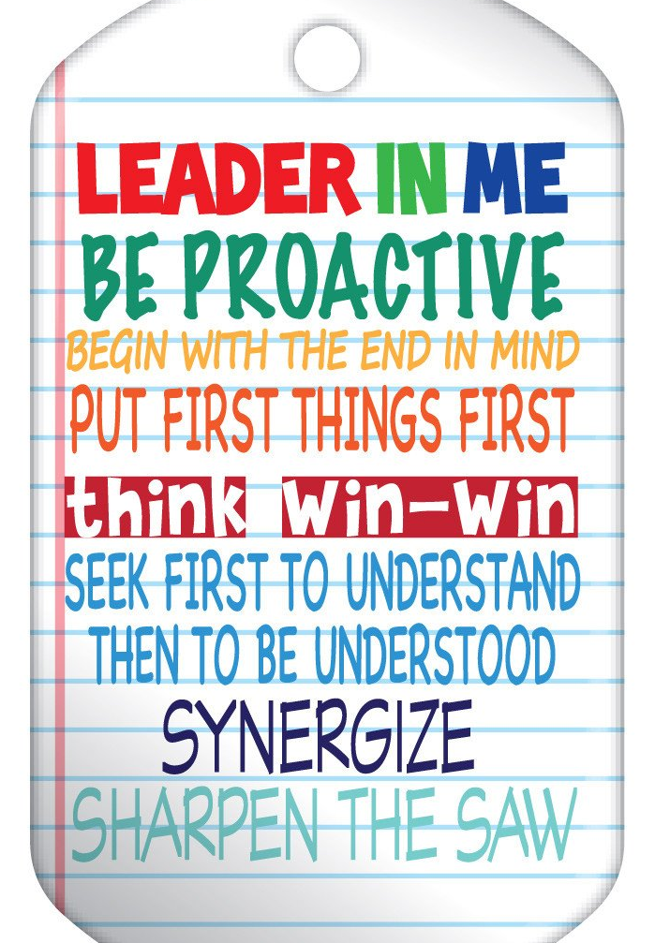
Why is Growth Mindset Important?
People with a Growth Mindset are more successful in school, in the workplace, & in their personal lives. Why?
Theory of Success & Achievement
Achievement = Skills + Effort
Skills – Knowledge & Ability
Effort - Deliberate Practice to Improve Abilities
World Class Pianist – 10,000 hours of Practice
Character Strengths & The 7 Habits
Self Discipline – Be Proactive & Put First Things First
Grit, Passion & Perseverance towards a particular goal - Begin with the End in Mind & Put First Things First
Mindset – Positive Beliefs and Attitudes towards Learning & Effort
Notes:
Erin - will discuss Growth Mindset and the character strengths associated with growth mindset
As parents and educators, school institution, flourish—purpose—why are we here
Successful; school, life, work, relationships
Achievement
Theory--Achievement=Skills x Effort
Skills are knowledge
Effort—Deliberate Practice
World class pianists practice 10,000 hours
2nd tier 5,000
Amateur professionals 2,000
Self-discipline;
Grit
Perseverance and passion towards a particular goal
Effort is something you can control
Mindset—belief, attitude-foundation

Slide 6
Why is Growth Mindset Important?
Research Behind Growth Mindset In Schools
  Growth Minded Students do better in school because:
    They have the character strengths mentioned in the last slide
    They have an empowering perspective on learning
    They focus on improvement
    They see effort as a way to build their abilities.
    They see failure as a natural part of the learning process.
  Students with a Growth Mindset:
    are more likely to do well in school over time
    are three times more likely to score in the top 20% nationally on assessments
    are more likely to be placed in advanced placement classes
    earn higher math grades over time
*Research presented on this slide can be found at www.mindsetkit.org
Notes:
Erin will present this slide

Slide 7

Promoting a Growth Mindset at Home
The Power of Praising the Process
A study on Praise and Mindset
Carol Dweck-The Effect of Praise on Mindset
Take Away:
  Praise the process-not the person
  Praise the effort-not the intelligence
Notes:
Lisa

Slide 8

Promoting a Growth Mindset at Home
Stop Saying “You are so smart!”
This is not easy to do, but this is key to promoting growth mindset
Take Away:
Do praise effort, hard work, and perseverance
Avoid Praising intelligence and ability
Praising Intelligence & Ability
Notes:
Lisa

Slide 9

Promoting a Growth Mindset at Home
The Power of “Yet”
Part of having a growth mindset is understanding the power of yet
Take Away
When your child is frustrated and saying I can’t do this, remind them that they can’t do it yet.
Notes:
Lisa

Slide 10
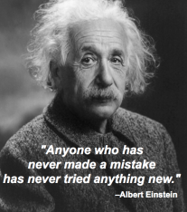
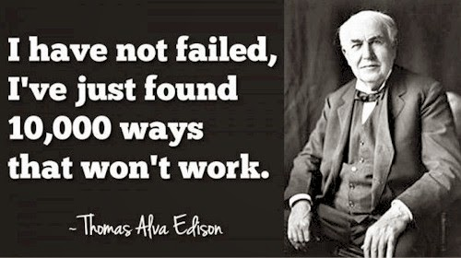
Promoting a Growth Mindset at Home
Celebrate Mistakes and Challenges!
Important words & attitudes to use when giving feedback to kids:
A Mistake! Interesting! What can I learn from it?
We failed. What can we learn?
This is hard – This is fun!
A Challenge! Yay! This is an opportunity to practice grit!
“YET” – I can’t do this yet!
Notes:
Lisa

Slide 11
Promoting a Growth Mindset at Home
Three Important Take Aways for Parents:
Recognize Your Own Mindset:
  Be mindful of your own thinking and of the messages you send with your words and actions.
Praise the Process:
  Focusing on the process helps our children see how their effort leads to success.
Model Learning From Failure:
  When parents talk positively about making mistakes, kids start to think of mistakes as a natural part of the learning process.
Notes:
Erin

Slide 12
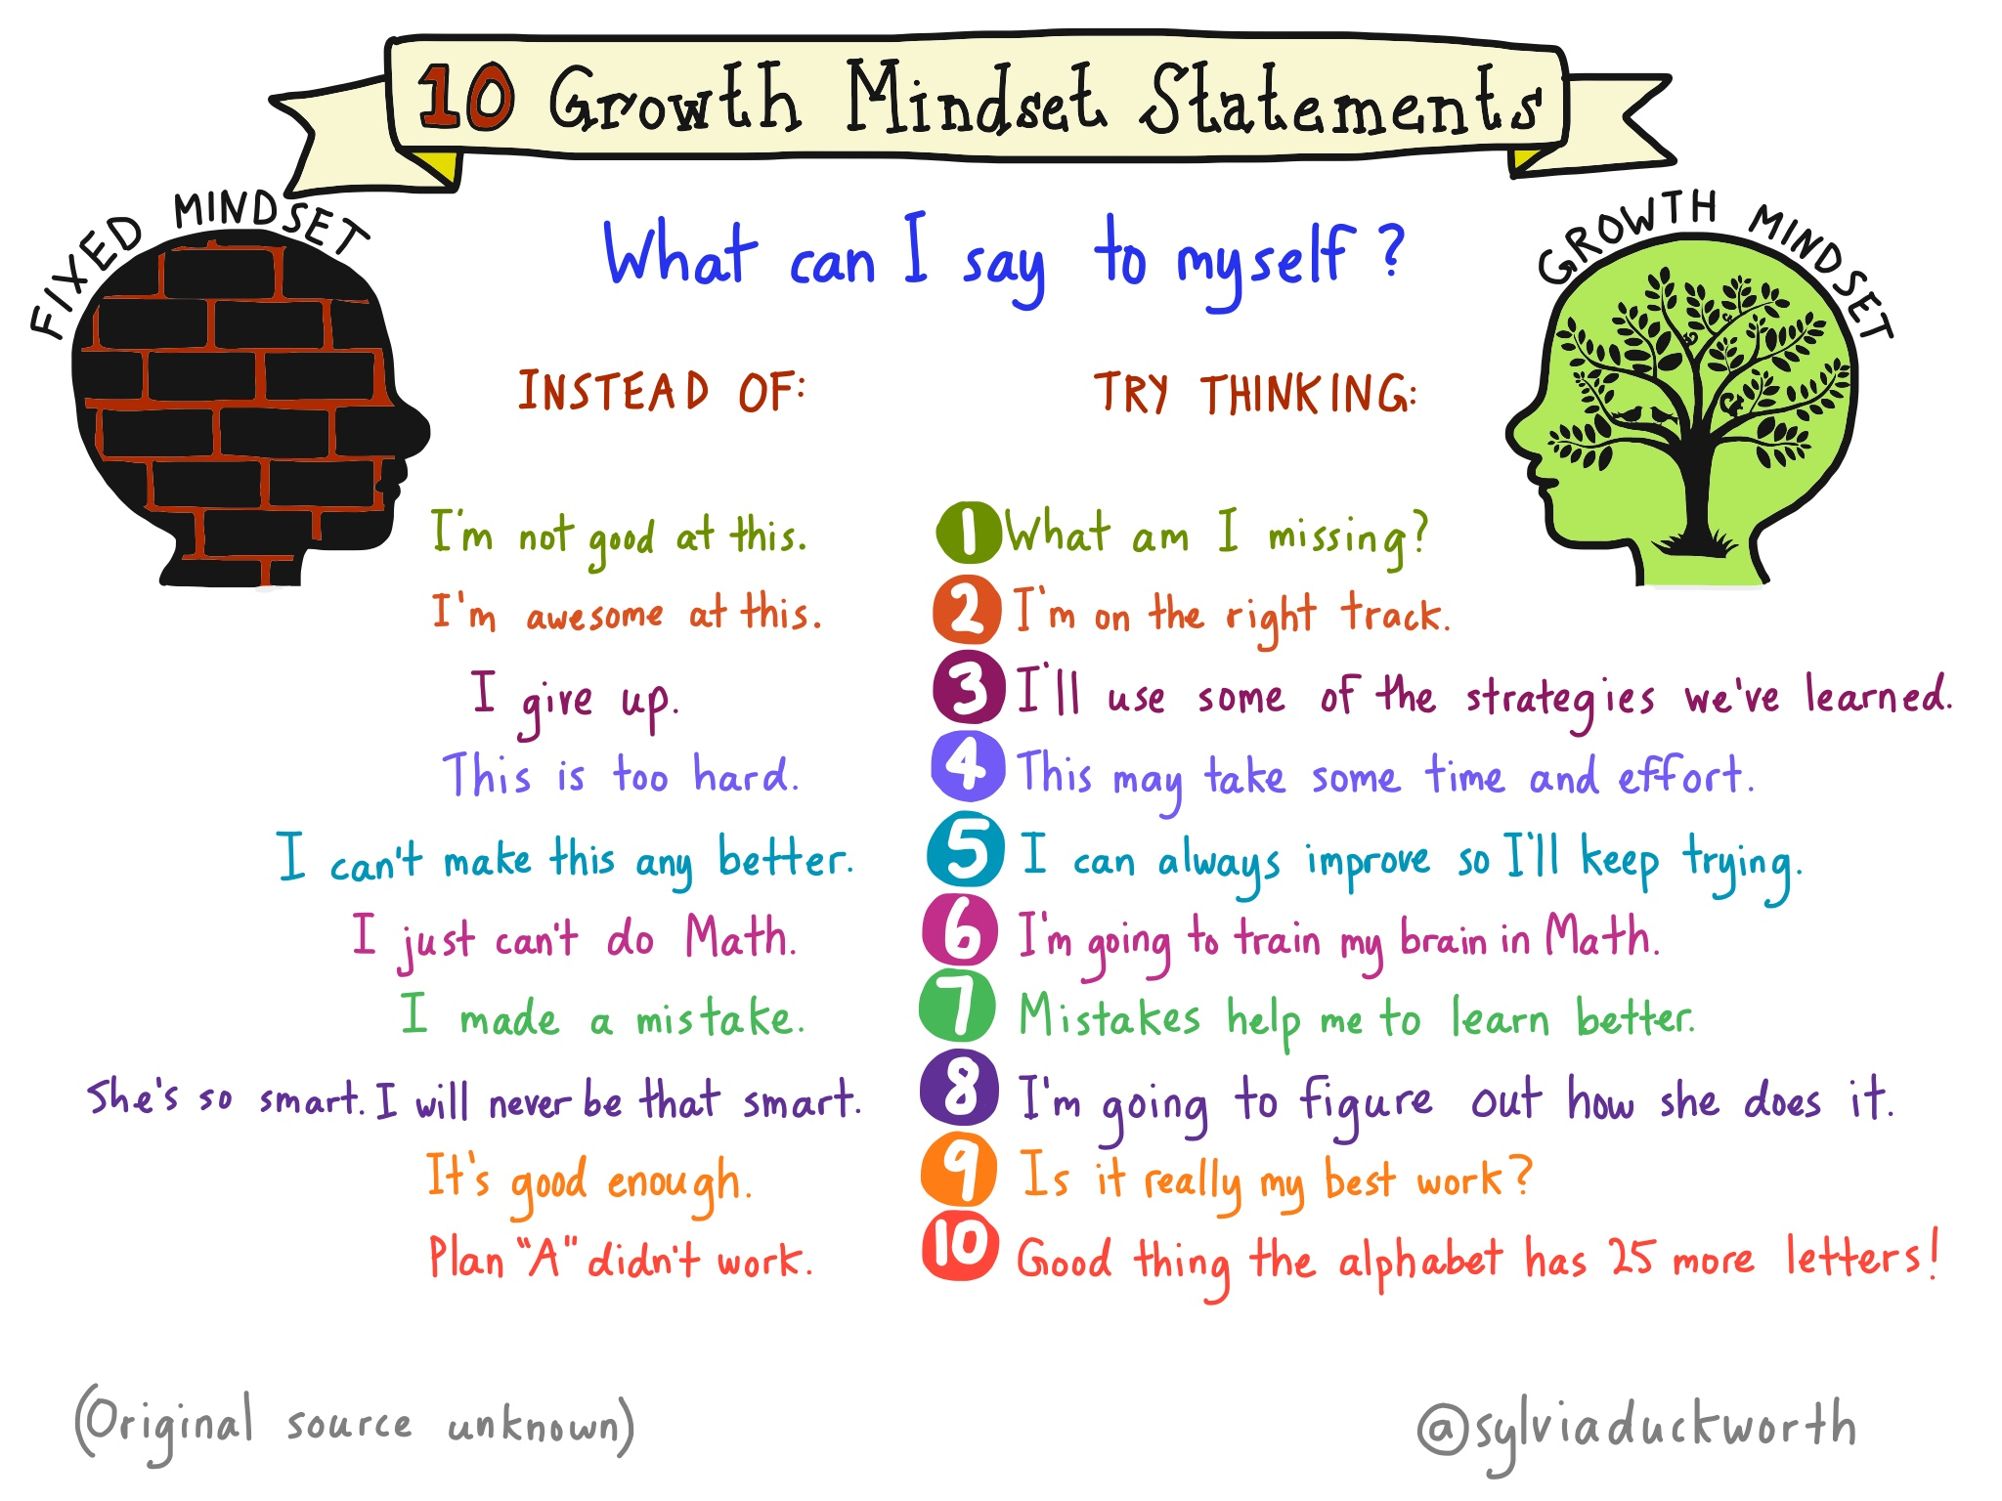
Notes:
Lisa

Slide 13







Promoting a Growth Mindset at Home
Resources for Parents:
Mindsetkit.org (click on the tab “For Parents”)
Mindsetworks.com
Class Dojo.com Big Idea - Growth Mindset
Notes:
Erin

Slide 14
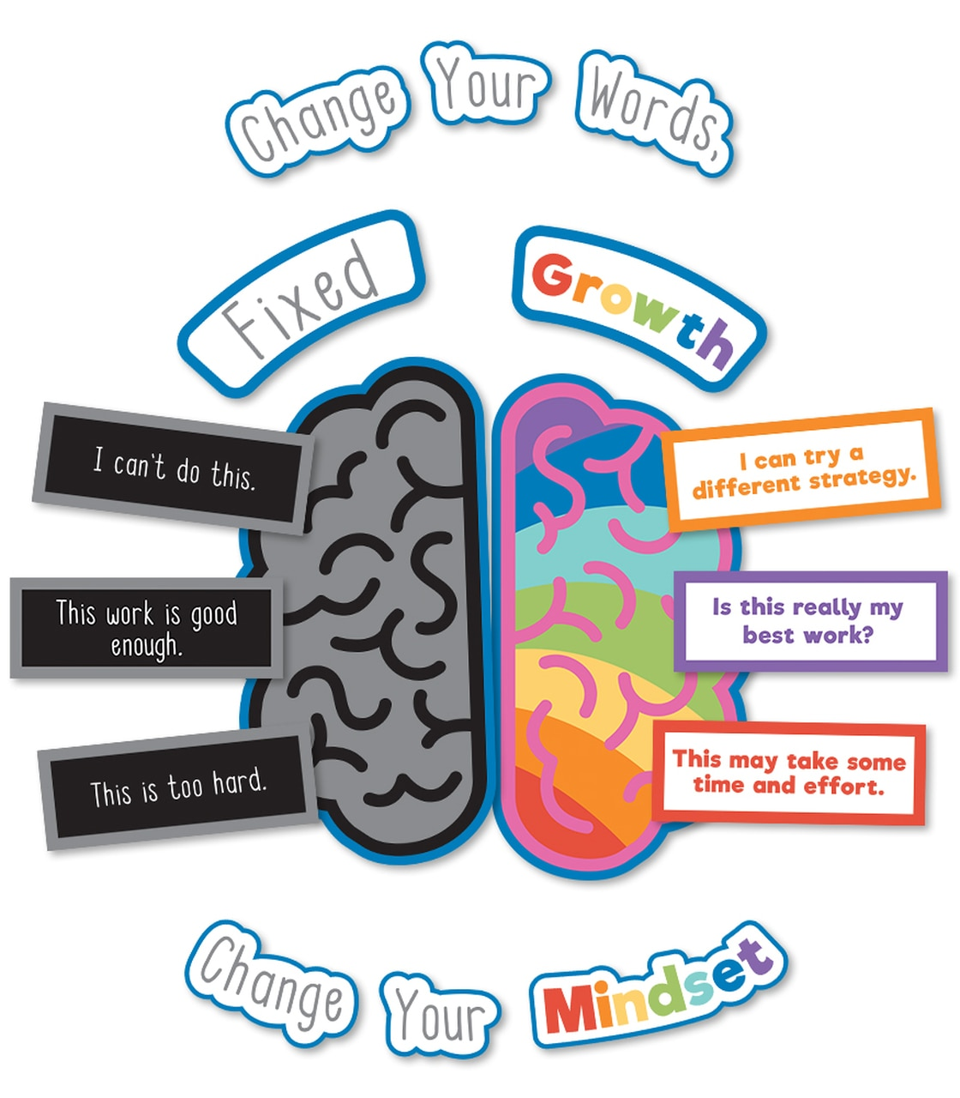
Wrap Up and Take Aways
Did we accomplish our Goals and Objectives?
We will understand what Growth Mindset is.
We will understand why Growth Mindset is important.
We will learn how to promote a Growth Mindset at home.
Please use the chat to tell us any Final Thoughts, Questions, or Take Aways?
Notes:
Erin and Lisa will wrap up

